Slide 1
Remote Branches

Slide 2
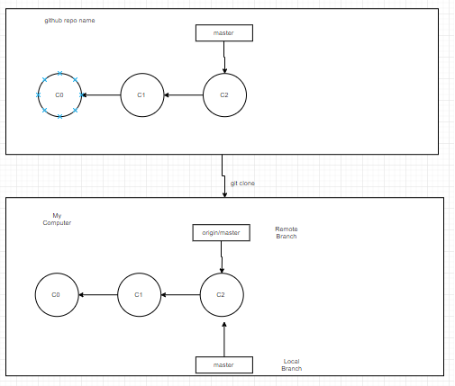
Server and local repositories after cloning

Slide 3
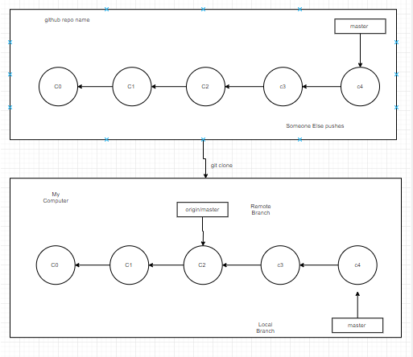
Local and remote work can diverge

Slide 4
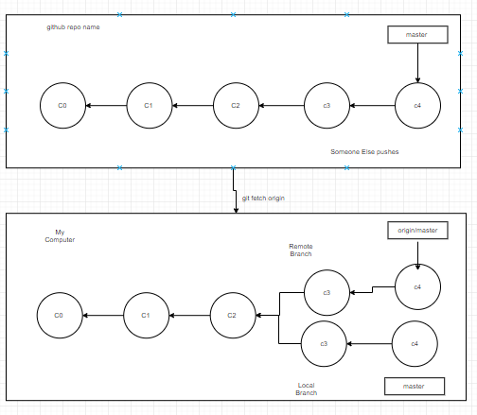
git fetch updates your remote-tracking branches

